Slide 1
Loan Approval Predictor
Group 5
Rajendra Bondili
Parm Basra
Ammar Bashoeb

Slide 2
Agenda
Project objective
Data Sources
Technology Used
Data Cleaning and Machine learning
Conclusion
Demonstration

Slide 3
Project Objective
Our Project Objective is to develop a comprehensive loan eligibility model that considers both historical loan data and key features (Applicant Income, Loan Amount, Credit History) as well as demographics (Gender, Dependents, Marital Status, Education).
The purpose of this model is to promote financial inclusion and reduce biases, ensuring fair access to loans for individuals from diverse backgrounds.

Slide 4

Data Sources
https://www.geeksforgeeks.org/ https://stackoverflow.com/ https://docs.github.com/ https://medium.com/

Slide 5
Technologies Used
Libraries Used
Python
Pandas
Scikit-learn
NumPy
Matplotlib
Seaborn
Bootstrap CSS
Pickle
Algorithms
Logistic Regression
DeNeural Network
Decision Tree
Support Vector Machine
K-Nearest Neighbours
Random Forest

Slide 6
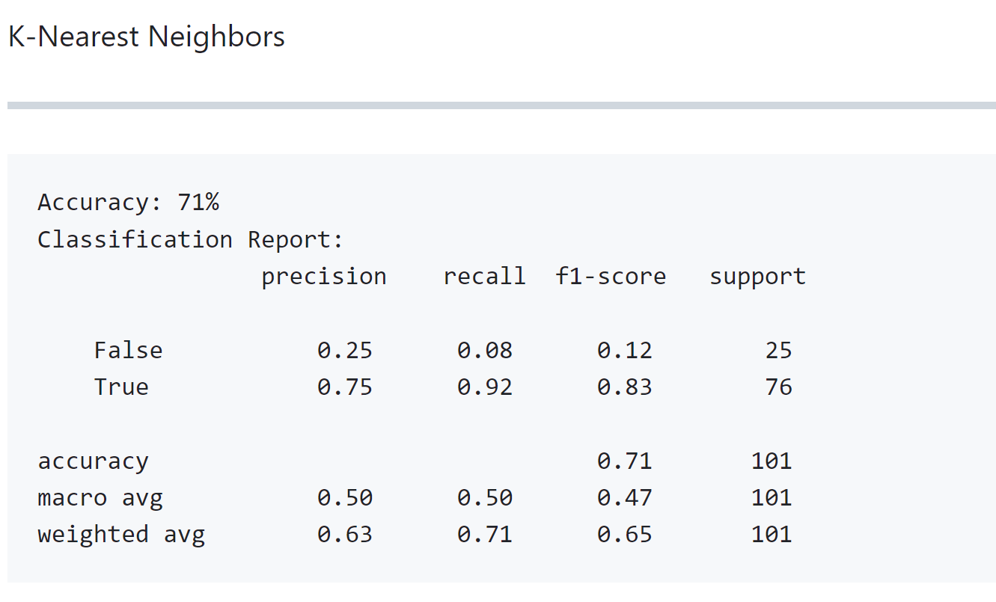
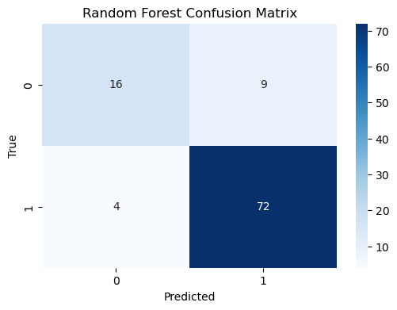
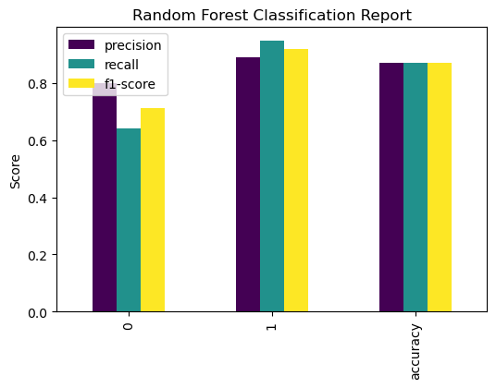
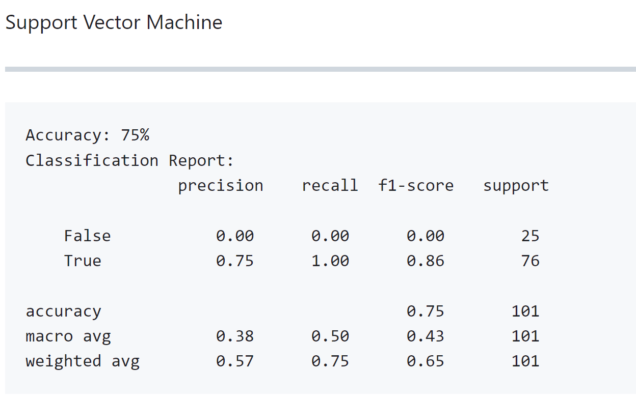
Data Cleaning and Machine learning
Random Forest
Model Accuracy: 87.13%
K-Nearest Neighbors
Model Accuracy: 71%
SVN and KNN
Model Accuracy: 75%

Slide 7
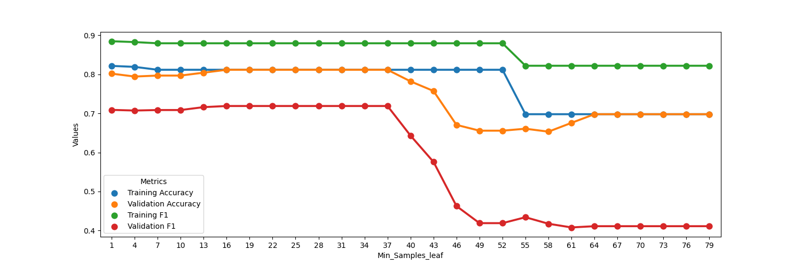
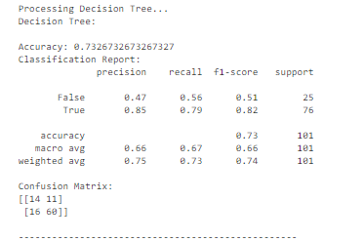
Feature Engineering:
Decision Tree
With max depth=3 and choosing min sample leaf as 25, it has accuracy score 73% with 20% of sample size of test data as below:

Slide 8
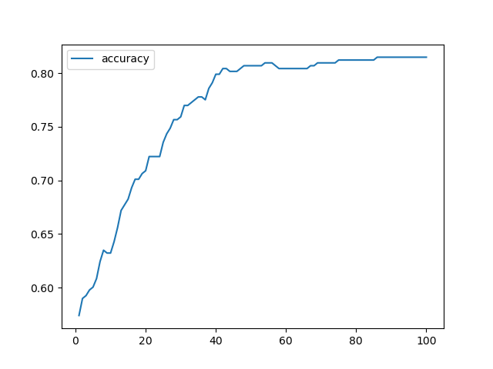
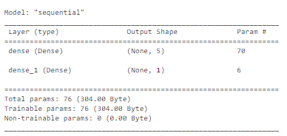

Feature Engineering:
Neural Network
With Rectified Linear unit which is a multi layered precision on 13 categorical values has shown better accuracy compared to Sigmoid model.
With 100 Epochs achieved accuracy rate of 82%

Slide 9
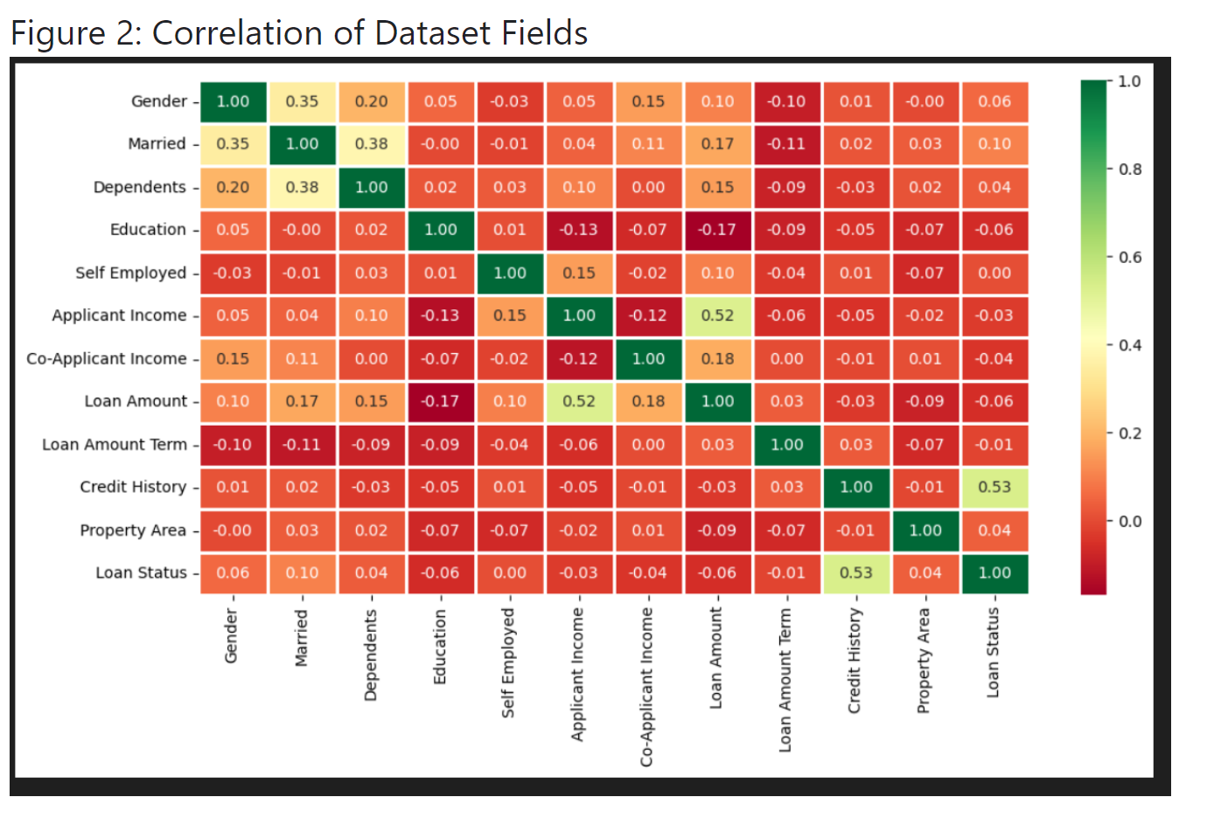

Slide 10
Limitations and Future Development
Future Development
Inclusive Data Collection: Collecting diverse and representative data to mitigate biases.
Fairness-aware Algorithms: Developing algorithms to identify and address biases in predictions.
Explainable AI: Integrating techniques to enhance the model's transparency.
Hybrid Models: Combining different algorithms for more accurate predictions.
Real-time Data: Utilizing real-time data for up-to-date loan approval decisions.
Ethical Frameworks: Implementing ethical guidelines for responsible AI adoption.
Limitations
Data Availability: The accuracy of the model relies on the availability and quality of historical loan data.
Biases in Historical Data: Biases in past lending practices may affect the fairness of predictions for underrepresented groups.
Complex Factors: The model may not fully capture all factors influencing loan approval decisions.
Model Interpretability: Some models lack transparency, making it difficult to explain predictions.

Slide 11
Conclusion
Loan approval prediction using machine learning can improve the efficiency and accuracy of loan processing in financial institutions.
By building a robust predictive model that considers key features and demographics, banks can better assess the risk associated with loan applicants and make informed decisions about loan approvals.
This project demonstrates the potential of machine learning in the finance industry to streamline the loan approval process and promote financial inclusion.

Slide 12
Demonstration

Slide 13
Questions?

Slide 14
Thank you for your attention ☺

